Slide 1
Patient Case Similarity
PIP2001 Capstone Project
Review-1
Batch Number: 02
Name | Roll Number
L. Akanksha | 20211CIT0047
Sanjana R | 20211CIT0043
Koyi Mithun | 20211CIT0055
B. Vishnuvardhan Reddy | 20211CIT0013
P. Sai Surya | 20211CIT0079
Under the Supervision of,
Dr. Sharmasth Vali Y
Associate Professor
School of Computer Science and Engineering
Presidency University
Name of the HoD: Dr. Anandaraj S P
Name of the Program Project Coordinator: Dr. Sharmasth Vali Y
Name of the School Project Coordinators: Dr. Sampath A K / Dr. Abdul Khadar A
/ Mr. Md Ziaur Rahman

Slide 2
Content
Problem Statement
Literature Review
Proposed Method vs Existing Method
Objectives
Methodology
Timeline of the Project
Expected Outcomes
References

Slide 3
Problem Statement Number:
Organization: ezDI
Category (Software): Healthcare & Biomedical Devices
Problem Description:
The objective of patient case similarity is to identify similar patients based on their medical reports. Identification of similar patient cases be useful for improving patient outcome, for treatment or drug recommendation to a new patient, prediction of clinical outcome, clinical decision support, research on those cases. Task: Applying machine learning algorithms to find similar patient cases from given dataset.
Difficulty Level: Complex

Slide 4
Literature Review
Data Quality and Completeness
Data Distribution
Data Noise
Data Privacy and Ethical Considerations

Slide 5

Advantages:
                Interpretability
                Non-parametric
                Handles both numerical and categorical data
                Can handle missing data
2. Limitations:
Overfitting
Sensitive to noise
Prone to bias

Slide 6
Proposed Method vs Existing Method
K-Nearest Neighbors (KNN)
How it works: KNN classifies new data points based on the majority class of their k nearest neighbors in the training dataset.
Strengths:
  Simple to understand and implement.
  No explicit training phase required.
  Can handle non-linear relationships.
  Effective for high-dimensional data.
Weaknesses:
  Can be computationally expensive for large datasets.
  Sensitive to the choice of distance metric and the value of k.
  Prone to overfitting with small datasets.

Slide 7

Decision Trees
How it works: Decision trees create a tree-like model where each internal node represents a test on an attribute, and each leaf node represents a class label.
Strengths:
  Interpretable and easy to visualize.
  Can handle both numerical and categorical data.
  Robust to outliers.
  Can be used for feature selection.
Weaknesses:
  Prone to overfitting, especially with deep trees.
  Sensitive to noise in the data.
  May not capture complex relationships between features.

Slide 8
Objectives
Python(ML)
Decision Tree Classifier(Algorithm)
HTML, CSS, JavaScript

Slide 9
Methodology
Methodology for a Patient Case Similarity Project Using Decision Trees
Data Collection and Preprocessing
Dataset Splitting
Decision Tree Construction
Model Evaluation
Model Deployment and Use

Slide 10
Timeline of the Project
Selection of dataset Training the model with the dataset using KNN algorithm Checking the accuracy of the model with respect to the dataset
Prediction of output to the new data Checking the accuracy of the model with respect to the outer data
Creating a user interface for the model Optional: we try to apply backend features to the model like storing the data
Phase-1
Phase-2
Phase-3

Slide 11
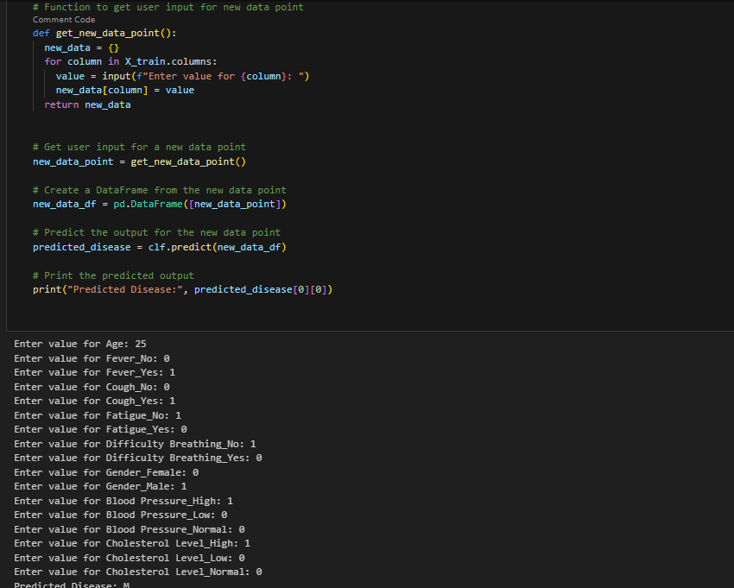
Expected Outcomes

Slide 12
References

Slide 13
References
6. How Healthcare Decision Trees Emerge and Function
Published online by Cambridge University Press: 13 July 2023
7. Machine learning of patient similarity: A case study on predicting survival in cancer patient after locoregional chemotherapy
Published in: 2010 IEEE International Conference on Bioinformatics and Biomedicine Workshops (BIBMW)
8. International Journal of Computer Science and Information Technology Research ISSN 2348-120X (online) Vol. 8, Issue 2, pp: (5-9), Month: April - June 2020, Available at: www.researchpublish.com
9. Brown, SA., Chung, B.Y., Doshi, K. et al. Patient similarity and other artificial intelligence machine learning algorithms in clinical decision aid for shared decision-making in the Prevention of Cardiovascular Toxicity (PACT): a feasibility trial design. Cardio-Oncology 9, 7 (2023). https://doi.org/10.1186/s40959-022-00151-0
10. Machine learning for integrating data in biology and medicine: Principles,
practice, and opportunities
2019, Information Fusion

Slide 14


Slide 15
